Slide 1
Go for Green® Menu Board & Build Your Own Templates

Slide 2
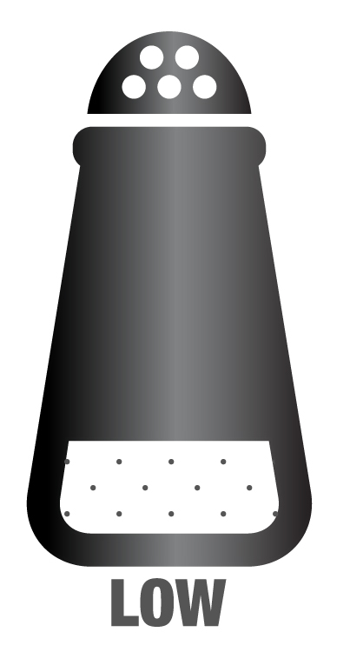
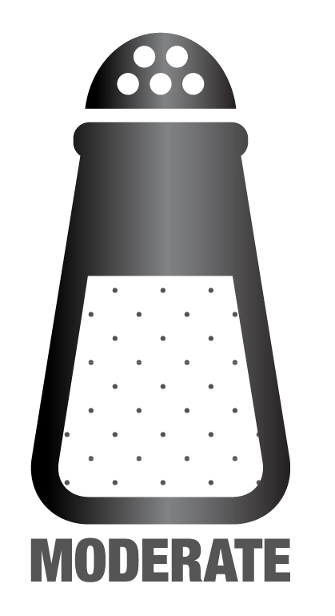
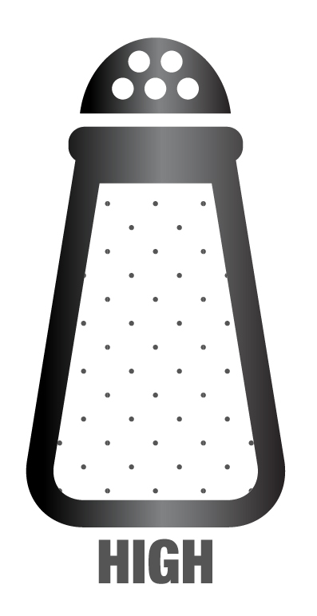
Station <insert name>
Station <insert name>
<Fill in your category>
<Fill in your category>
<Fill in your category>
<Fill in your category>
Notes:
MENU BOARD TEMPLATE

Slide 3
Station <insert name>
Station <insert name>
<Fill in your category>
<Fill in your category>
<Fill in your category>
<Fill in your category>
<Fill in your category>
Notes:
MENU BOARD TEMPLATE

Slide 4
Build Your Own <insert name>
1
Pick Your Base
3
Pick Your Toppings
2
Pick Your Protein
Try a “Featured Meal”:
<Base> + <protein> + <topping> + <topping> + <topping> + <topping>
Notes:
BUILD YOUR OWN TEMPLATE
OPTION #1: If using the “Menu Board Template” along with the “Build Your Own”, use this template (color codes only)

Slide 5
Build Your Own <insert name>
1
Pick Your Base
3
Pick Your Toppings
2
Pick Your Protein
Try a “Featured Meal”:
<Base> + <protein> + <topping> + <topping> + <topping> + <topping>
Notes:
BUILD YOUR OWN TEMPLATE
OPTION #2: If not using the “Menu Board Template” along with the “Build Your Own”, use this template (color codes + sodium codes)

Slide 6
SAMPLES

Slide 7
Fitness Bar
BASE
FRUIT
 | Yogurt
 | Cottage cheese
 | Cantaloupe
 | Grapes
 | Watermelon
 | Pineapple
 | Honeydew
 | Cranberries
 | Blueberries
TOPPINGS
 | Granola
 | Mixed nuts
 | Salsa
 | Jalapenos
CONDIMENTS
VEGETABLES
 | Cream cheese Peanut butter Butter
 | Carrot sticks
 | Celery sticks

Slide 8
Build Your Own Breakfast Burrito
1
Pick Your Tortilla
3
Pick Your Toppings
 | Potatoes Spinach Tomatoes Onions Mushrooms Jalapenos
 | White rice Shredded cheese
2
Pick Your Protein
 | Ground beef
 | Turkey links Bacon Chorizo
Try a Spicy Beef Burrito:
Whole-wheat tortilla + ground beef + potatoes + spinach + jalapenos + onions + tomatoes + shredded cheese
Notes:
Note: Can remove the sodium shaker symbols if using a Menu Board along with the Build Your Own

Slide 9
Build Your Own Breakfast Bowl
1
Pick Your Base
2
Pick Your Protein
 | Potatoes Spinach
 | White rice
 | Ground beef
 | Turkey links Bacon Chorizo
3
Pick Your Toppings
 | Spinach Tomatoes Onions Mushrooms Jalapenos
 | Shredded cheese
Try a Savory Chorizo Bowl:
Potatoes + chorizo + spinach + onions + mushrooms
Notes:
Note: Can remove the sodium shaker symbols if using a Menu Board along with the Build Your Own

Slide 10
Build Your Own Fitness Bowl
1
Pick Your Base
 | Yogurt Cottage cheese
Try a Sunshine Bowl:
Yogurt or cottage cheese + pineapple + granola
2
Pick Your Toppings
 | Cantaloupe Honeydew Grapes Watermelon Pineapple Cranberries Blueberries Granola Mixed nuts
Try a Sweet & Savory Bowl:
Yogurt or cottage cheese + cranberries + blueberries + mixed nuts
Notes:
Note: Can remove the sodium shaker symbols if using a Menu Board along with the Build Your Own

Slide 11
Salad Bar
BASE
TOPPINGS
 | Romaine lettuce
 | Spinach
 | Cherry tomatoes
 | Cucumbers
 | Shredded carrots
 | Jalapenos
 | Mushrooms
 | Green peppers
 | Onions
 | Broccoli
 | Shredded cheese
 | Bacon bits
PROTEIN
 | Tuna
 | Chickpeas
 | Eggs
DRESSINGS
 | Oil & vinegar
 | Italian
 | Ranch

Slide 12
Build Your Own Salad
1
Pick Your Base
3
Pick Your Toppings
 | Romaine lettuce Spinach
 | Cherry tomatoes Cucumbers Shredded carrots Mushrooms Green peppers Onions Broccoli Jalapenos
 | Shredded cheese
2
Pick Your Protein
 | Tuna Chickpeas
 | Eggs
Try a Tex-Mex Salad:
Romaine lettuce + cherry tomatoes + onions + green peppers + jalapenos + Ranch dressing
4
Pick Your Dressing
 | Oil & vinegar
 | Ranch Italian
Notes:
Note: Can remove the sodium shaker symbols if using a Menu Board along with the Build Your Own

Slide 13
Mongolian Grill
BASE
TOPPINGS
 | Whole-wheat pasta
 | White rice
 | Rice noodles
 | Cabbage
 | Broccoli
 | Bean sprouts
 | Mushrooms
 | Zucchini
 | Carrots
 | Spinach
 | Red onions
 | Bell peppers
 | Pineapple
 | Banana peppers
 | Jalapenos
PROTEIN
 | Chicken fajita strips
 | Shrimp
 | Tofu
SAUCES
 | Buffalo
 | Teriyaki
 | Sweet & sour

Slide 14
Build Your Own Bowl
1
Pick Your Base
3
Pick Your Toppings
 | Whole-wheat pasta
 | White rice Rice noodles
 | Cabbage Broccoli Bean sprouts Mushrooms Zucchini Carrots Spinach Red onions Bell peppers Jalapenos Banana peppers Pineapple
2
Pick Your Protein
*see rotating items*
Try a Veggie Pasta Bowl:
Whole-wheat pasta + bean sprouts + zucchini + spinach + onions + bell peppers + carrots
4
Pick Your Dressing
Notes:
Note: Can remove the sodium shaker symbols if using a Menu Board along with the Build Your Own

Slide 15
Taco Bar
PROTEIN
TOPPINGS
 | Shredded chicken
 | Carne asada
 | Pork carnitas
 | Shredded lettuce
 | Salsa verde
 | Salsa roja
 | Guacamole
 | Cilantro corn
 | Pico de gallo
 | Cheese sauce
 | Sour cream
 | Shredded cheese
BASE
 | Cilantro brown rice
 | Black beans
 | Kidney beans
 | Cilantro white rice
 | Tortillas

Slide 16
Build Your Own Burrito Bowl
1
Pick Your Base
3
Pick Your Toppings
 | Cilantro brown rice
 | Kidney beans Black beans
 | Cilantro white rice Tortillas
 | Shredded lettuce Salsa verde Salsa roja Guacamole Cilantro corn Pico de gallo
 | Cheese sauce Sour cream
2
Pick Your Protein
 | Shredded chicken
 | Carne asada Pork carnitas
Try a Fajita Chicken Burrito Bowl:
Cilantro brown rice + black beans + shredded chicken + shredded lettuce + cilantro corn + pico de gallo + guacamole
Notes:
Note: Can remove the sodium shaker symbols if using a Menu Board along with the Build Your Own

Slide 17
Deli Bar
PROTEIN
TOPPINGS
 | Chicken Caesar
 | Roast beef
 | Meatballs (L)/Reuben (D)
 | Turkey
 | Tuna salad
 | Ham
 | Lettuce
 | Tomatoes
 | Cucumbers
 | Bell peppers
 | Red onions
 | Pickles
 | Avocado
 | Banana peppers
 | Jalapenos
CONDIMENTS
 | Oil & vinegar; Hummus
 | Mustard
 | Ranch
 | Mayonnaise
 | Italian dressing
 | Buffalo sauce

Slide 18
Build Your Own Sandwich
1
Pick Your Bread
3
Pick Your Toppings
 | Lettuce Tomatoes Cucumbers Bell peppers Onions Pickles Avocado Banana peppers
 | Jalapenos
2
Pick Your Protein
 | Chicken Caesar
 | Roast beef Meatballs (lunch) Reuben (dinner)
 | Turkey Tuna salad
 | Ham
4
Pick Your Dressing
Try a Veggie Pocket:
Whole-wheat pita + tomatoes + cucumbers + bell pepper + jalapenos + avocado
Notes:
Note: Can remove the sodium shaker symbols if using a Menu Board along with the Build Your Own

